Slide 1
Evolution of computers
Lecture # 1
A Brief History and Generations

Slide 2
Definition of computer
Earliest computer
Computer History
Computer Generations

Slide 3
Learning outcomes
To know the evolution of computers.
To know the early computing devices and their Inventors.
To know the five generations and their characteristics.
To know Different types of Computers

Slide 4
Definition ?

Slide 5
Definition of Computer
Computer is a programmable machine.
Computer is a machine that manipulates data according to a list of instructions.
Computer is any device which aids humans in performing various kinds of computations or calculations.

Slide 6
Definition of Computer
Three principles characteristic of computer:
It responds to a specific set of instructions in a well defined manner.
It can execute a pre-recorded list of instructions.
It can quickly store and retrieve large amounts of data.

Slide 7
Earliest Computer
Originally calculations were computed by humans, whose job title was computers.
These human computers were typically engaged in the calculation of a mathematical expression.
The calculations of this period were specialized and expensive, requiring years of training in mathematics.
The first use of the word "computer" was recorded in 1613, referring to a person who carried out calculations, or computations, and the word continued to be used in that sense until the middle of the 20th century.

Slide 8
History of Computers
Pre-Mechanical Computing
Mechanical computers
Electro-mechanical computers
Electronic digital computers

Slide 9
Pre-Mechanical Computing
From Counting on fingers to pebbles to hash marks on walls to hash marks on bone to hash marks in sand
Interesting thought:
Do any species, other than homo sapiens, count?
Notes:
Before humans invented “machines” to help them count or do math, they used whatever was at hand (pardon the pun!).
In the initial years of the development of human civilizations probably the fingers of our hands were the most common instrument to count the things, like one finger for one & two fingers for two & so on. Then many other things like sticks, small stones & other objects available naturally in abundant numbers were used to help counting. Different civilizations grew & chosen their own methods of counting. As the trading started for various items & people came into contact with other civilizations, the need for counting & calculations grew many folds. Different civilizations invented different numerals to be used for counting. The invention of zero by India is very significant in this context. Different numerals used for counting have been shown in figure. With coming of numerals the system of writing them came into being. The decimal number system is now most prevalent universally. Slowly & slowly various civilizations contributed to the different aspects of mathematics. So, What we are doing today with the help of mathematics is the outcome of thousands of years of sustained research & growth.

Slide 10
Mechanical computers
In the early years, before the computer was invented, there are several inventions of counting machines. Can you name?

Slide 11
Mechanical computers
From
The Abacus
c. 4000 BCE
to
Charles Babbage
and his Difference Engine (1812)

Slide 12
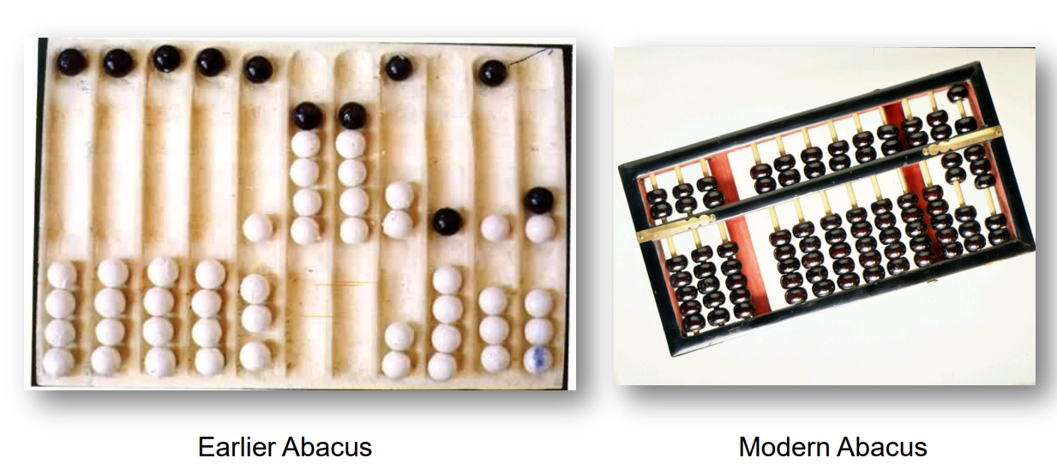
Mechanical computers
The Abacus (3000 BCE)
The abacus is still a mainstay of basic computation in some societies. Slide the beads up and down on the rods to add and subtract.
Notes:
The abacus is still a mainstay of basic computation in some societies. Slide the beads up and down on the rods to add and subtract.

Slide 13
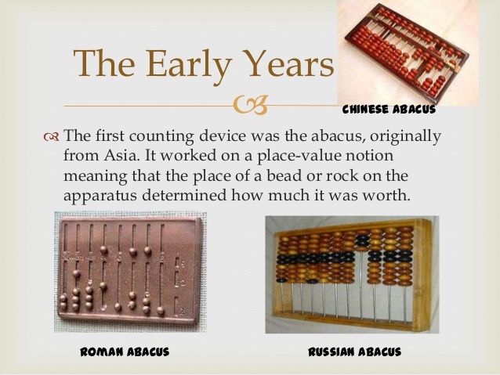
Mechanical computers

Slide 14
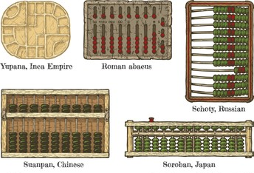
Mechanical computers
Abacuses Around the world

Slide 15
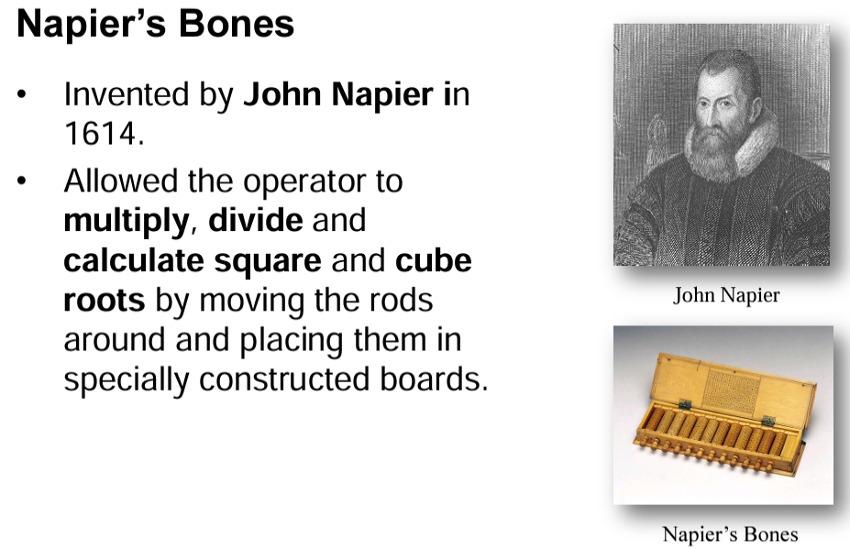
Mechanical computers

Slide 16
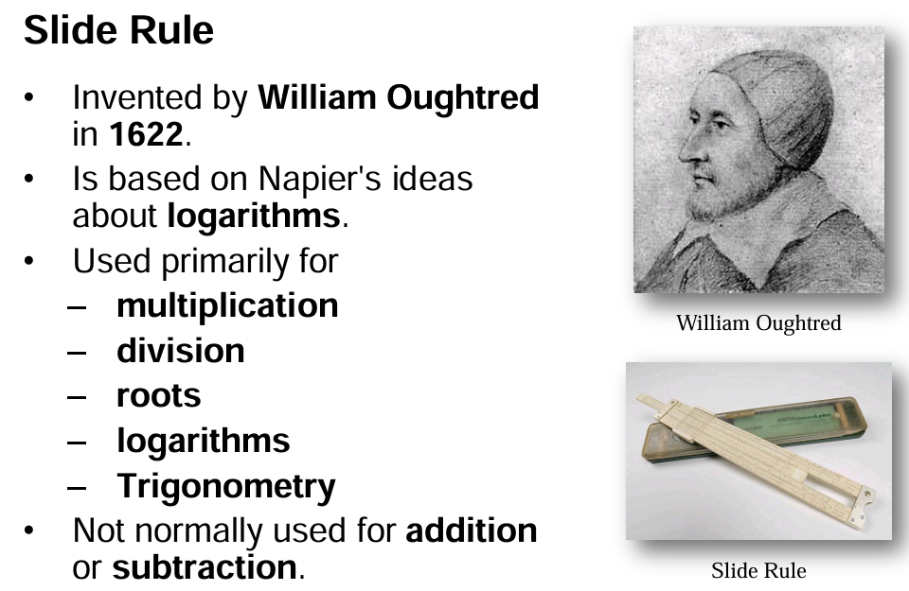
Mechanical computers

Slide 17
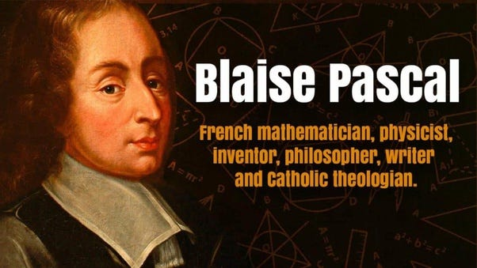
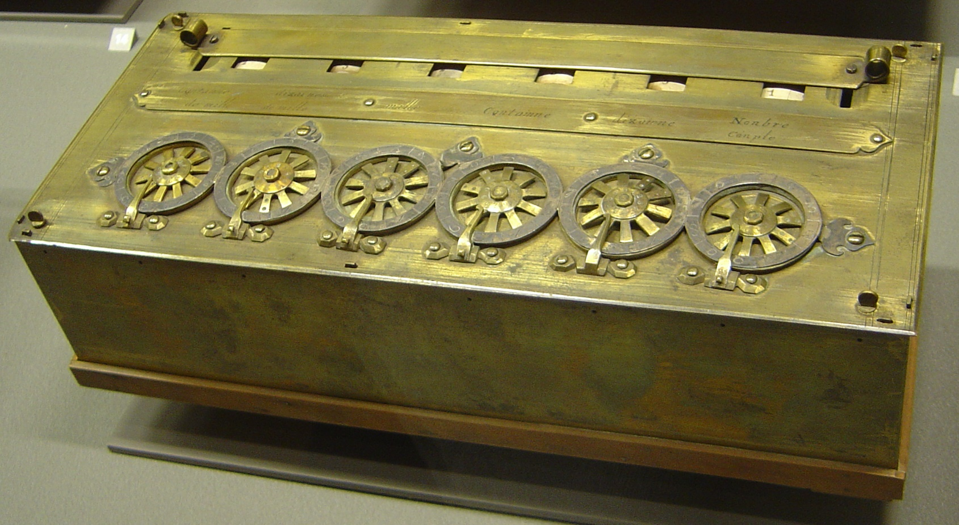
Mechanical computers
This famous French philosopher and mathematician invented the first digital calculator to help his father with his work collecting taxes. He worked on it for three years between 1642 and 1645. The device, called the Pascaline, resembled a mechanical calculator of the 1940's. It could add and subtract by the simple rotation of dials on the machine’s face.

Slide 18
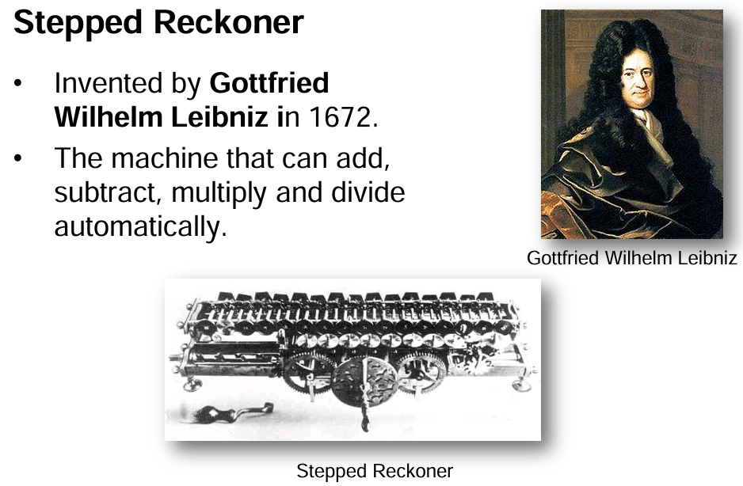
Mechanical computers

Slide 19
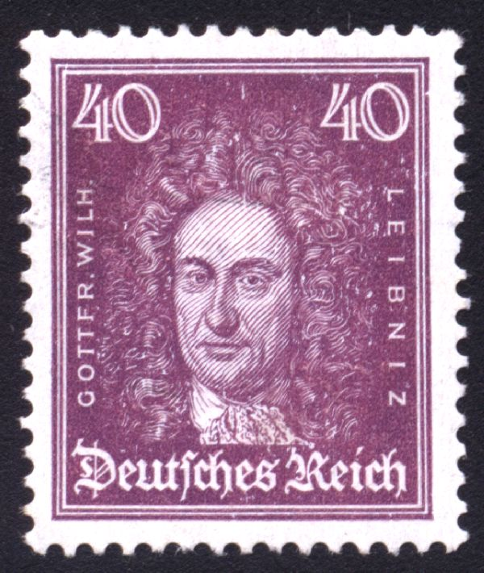
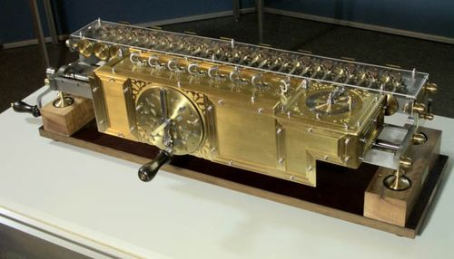
Mechanical computers
Gottfried Wilhelm von Leibnitz’s Stepped Reckoner (1674)
Leibnitz’s Stepped Reckoner could not only add and subtract, but multiply and divide as well. Interesting thing about the Stepped Reckoner is that Leibnitz’s design was way ahead of his time. A working model of the machine didn’t appear till 1791, long after the inventor was dead and gone.

Slide 20
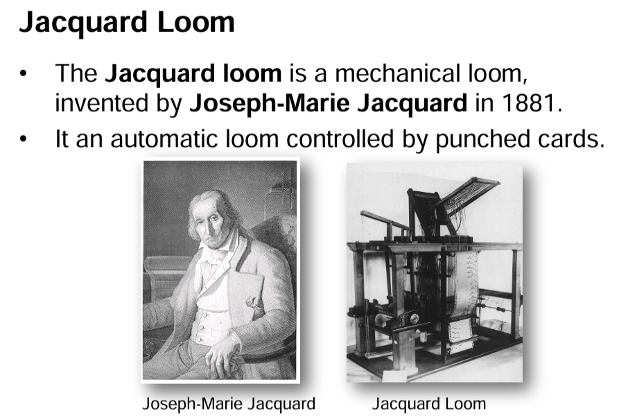
Mechanical computers

Slide 21
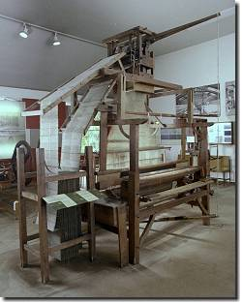
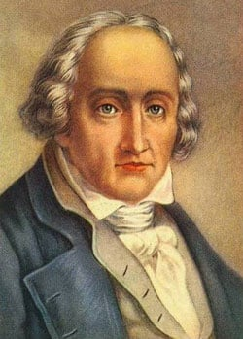
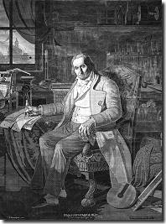
Mechanical computers
Joseph-Marie Jacquard and his punched card controlled looms (1804)
Notes:
Joseph-Marie Jacquard was a weaver. He was very familiar with the mechanical music boxes and pianolas, pianos played by punched paper tape, which had been around for some time. One day he got the bright idea of adapting the use of punched cards to control his looms. If you look carefully at the picture on the right, and those on the following slide, you can see a continuous roll of these cards, each linked to the other, the holes in them punched strategically to control the pattern of the weave in the cloth produced by the loom. All the weaver had to do was work the loom without needing to think about the design of the cloth. Brilliant! Jacquard revolutionized patterned textile weaving. His invention also provided a model for the input and output of data in the electro-mechanical and electronic computing industry.
The picture of Jacquard on the left, based on a copper portrait, was woven with the aid of one of his machines!

Slide 22
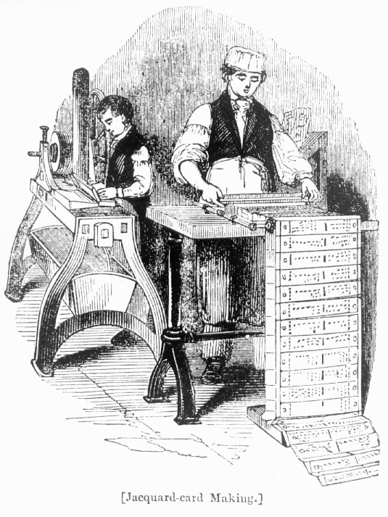
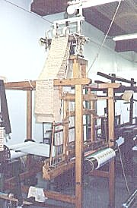
Mechanical computers
Preparing the cards with the pattern for the cloth to be woven
Notes:
Here you see Jacquard’s workers preparing the cards for the looms. The looms became known as Jacquard looms, and today one of the premier fabric manufacturers is named after Joseph-Marie Jacquard.

Slide 23
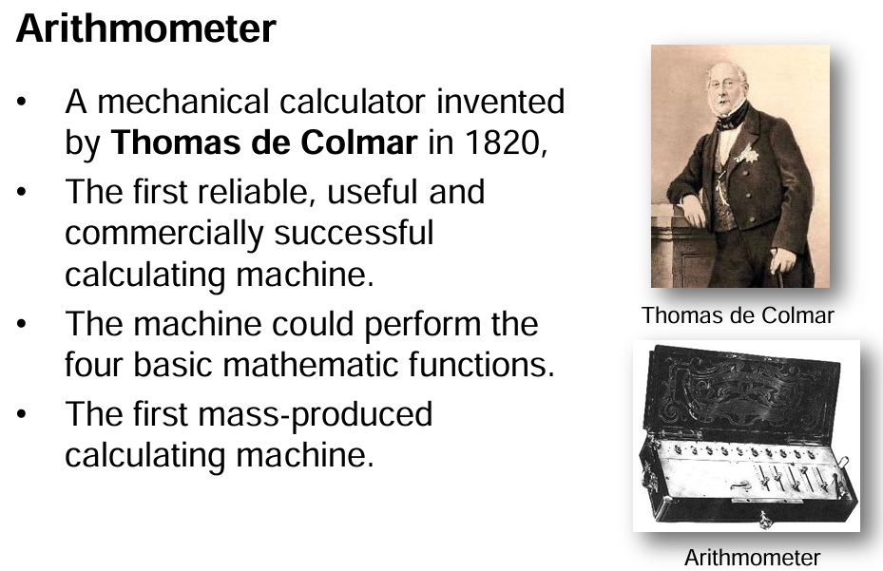
Mechanical computers

Slide 24
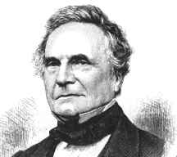
Charles Babbage (1791-1871) The Father of Computers
Notes:
Charles Babbage is recognized today as the Father of Computers because his impressive designs for the Difference Engine and Analytical Engine foreshadowed the invention of the modern electronic digital computer. Try and get a biography of Babbage if you can. He led a fascinating life, as did all the folks involved in the history of computers. He also invented the cowcatcher, dynamometer, standard railroad gauge, uniform postal rates, occulting lights for lighthouses, Greenwich time signals, heliograph opthalmoscope. He also had an interest in cyphers and lock-picking, but abhorred street musicians.

Slide 25
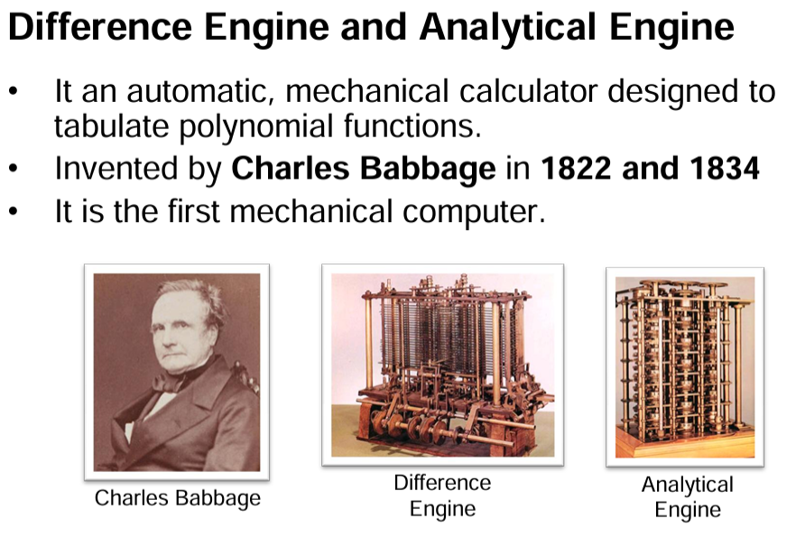
Mechanical computers

Slide 26
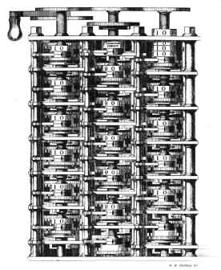
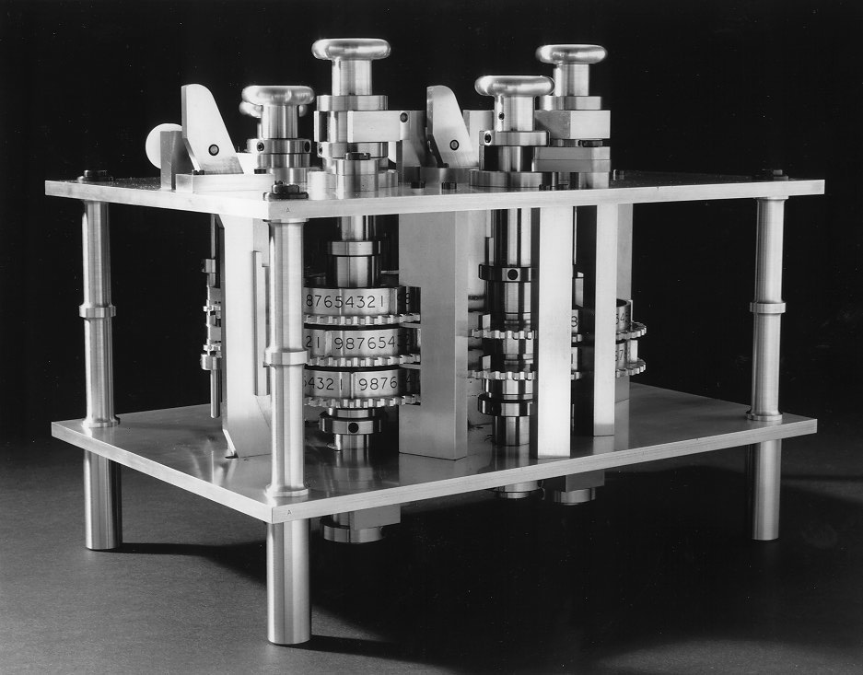
Mechanical computers
Charles Babbage’s Difference Engine
Notes:
The precision machine tooling that produced these intricate machines could not have been achieved in an earlier age. Babbage’s inventions were born of the advances in technology that accompanied the Industrial Revolution. The Difference Engine was never fully built. Babbage drew up the blueprints for it while still an undergrad at Cambridge University in England. But while it was in process of being manufactured, he got a better idea and left this work unfinished in favor of the Analytical Engine illustrated on the next slide. The Analytical Engine was eventually built completely in the latter half of the 19th century, by Georg and Edvard Schuetz as per Babbage’s blueprints. Film footage exists of the machine in operation, and it is truly a sight to behold, a testament not only to Babbage’s genius, but also to the manufacturing prowess of the age.

Slide 27
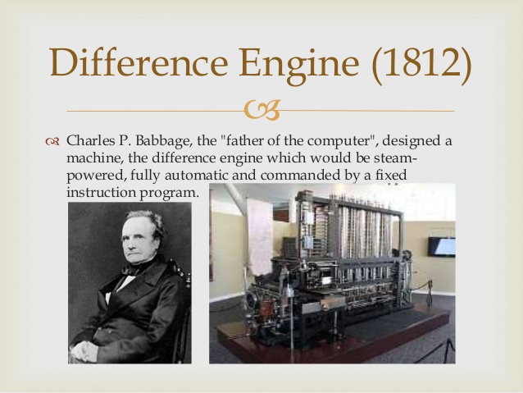
Mechanical computers

Slide 28
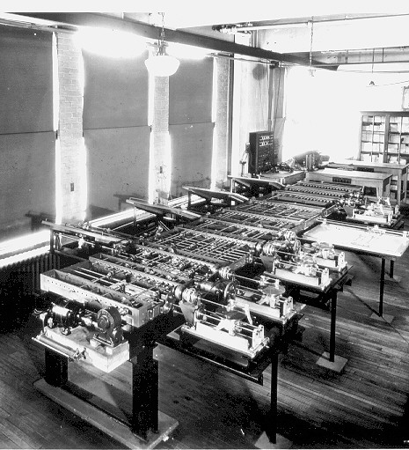
Mechanical computers
Charles Babbage’s Analytical Engine
Beautiful….. The Science Museum in South Kensington, London, England has an impressive display of Babbage’s work which can also be researched on the web at http://www.sciencemuseum.org.uk/.

Slide 29
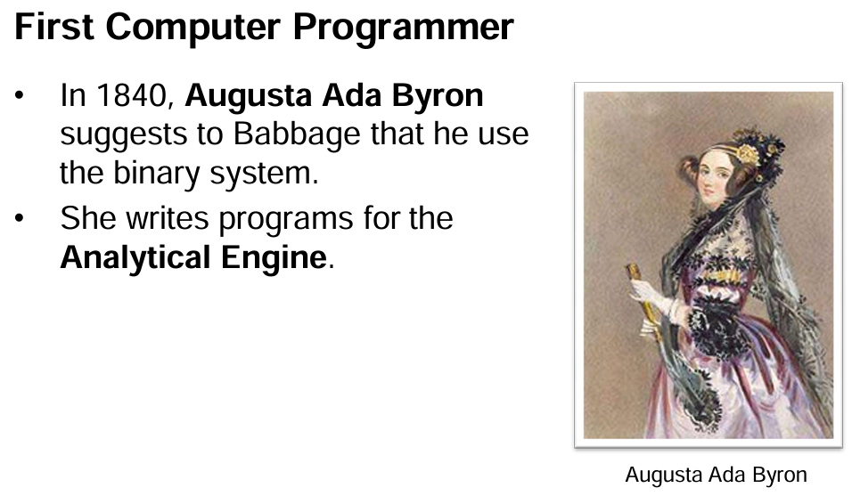
Mechanical computers

Slide 30
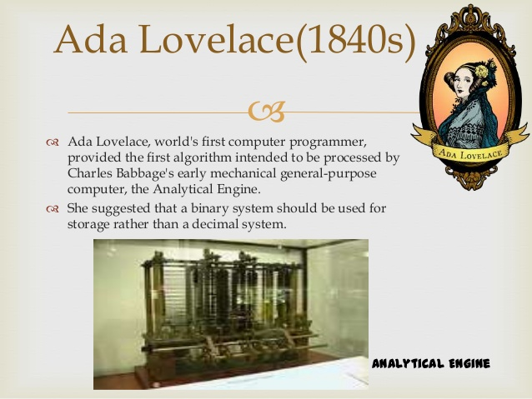
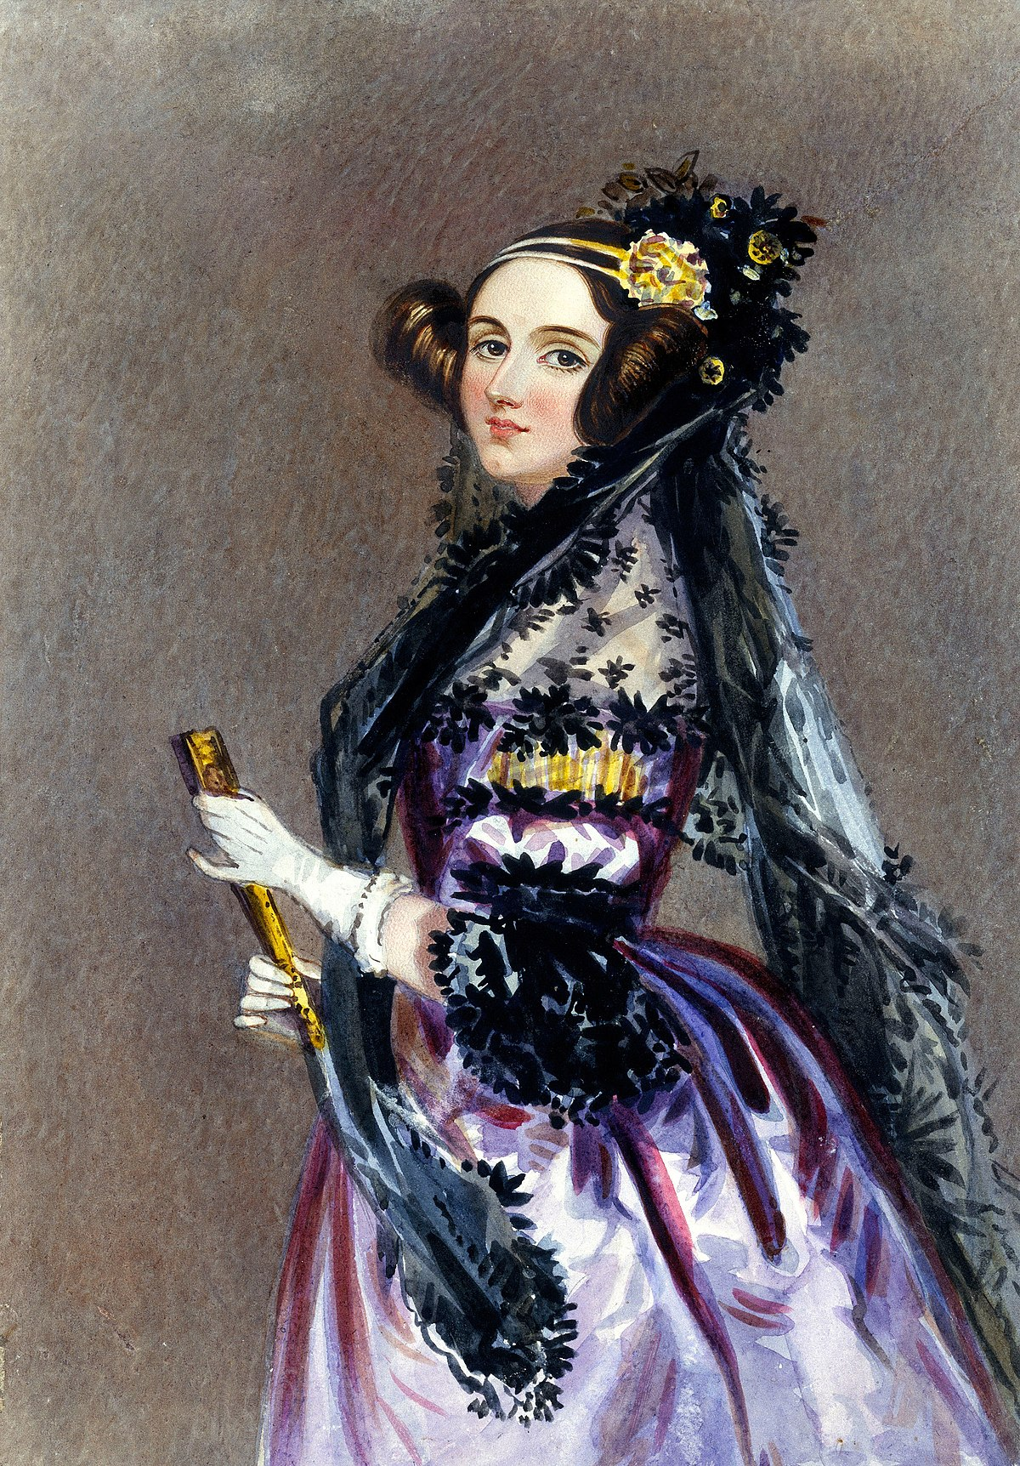
Mechanical computers
Notes:
Babbage owes a great debt to Lady Augusta Ada, Countess of Lovelace. Daughter of the famous romantic poet, Lord Byron, she was a brilliant mathematician who helped Babbage in his work. Above all, she documented his work, which Babbage never could bother to do. As a result we know about Babbage at all. Lady Augusta Ada also wrote programs to be run on Babbage’s machines. For this, she is recognized as the first computer programmer. Remember that guys. Women are just as talented as men when it comes to math, science, and engineering, and society should recognize that and do its utmost to encourage girls to get into these important and lucrative fields.

Slide 31
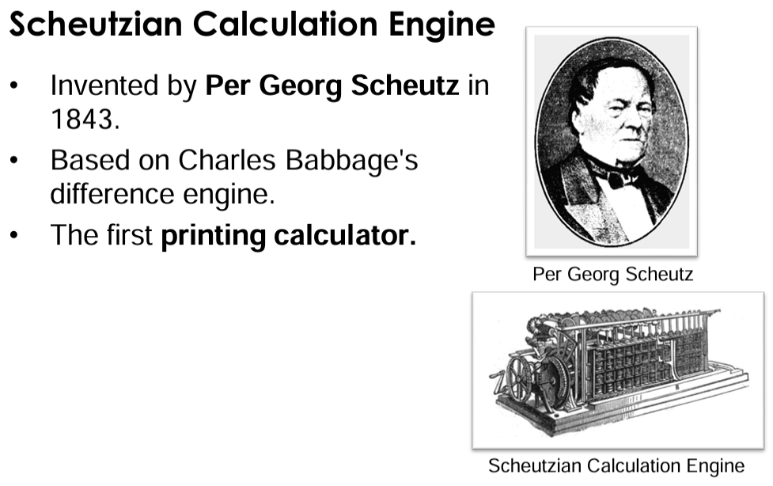
Mechanical computers

Slide 32
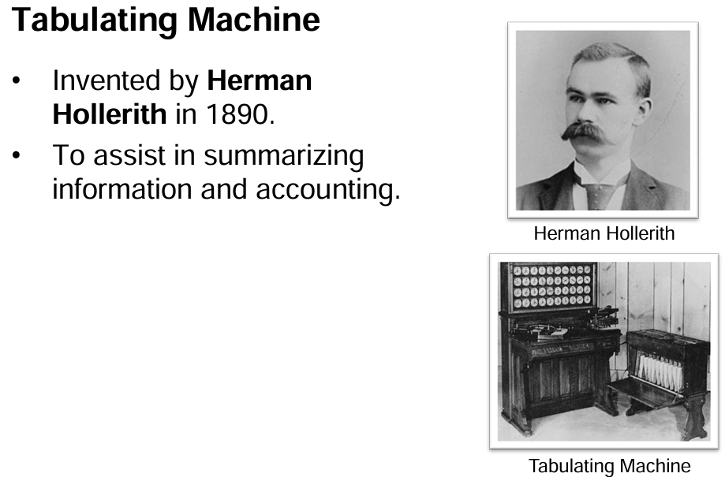
Mechanical computers

Slide 33
Electro-mechanical computers
From
Herman Hollerith’s
1890
Census Counting Machine
to
Howard Aiken
and the Harvard Mark I (1944)

Slide 34
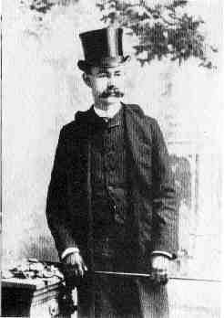
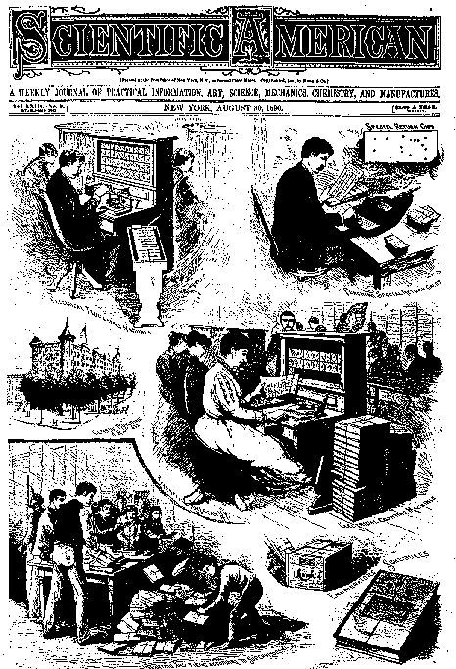
Electro-mechanical computers
Herman Hollerith and his Census Tabulating Machine (1884)
Notes:
Herman Hollerith worked as a statistician for the U.S. Census Bureau in the 1880s and 1890s. The U.S. Constitution requires a census count every ten years so that the membership of the House of Representatives will be proportional to the population of each state. This is always a moving target, hence the ten year review of the current state of demographic affairs. The 1880 census took seven years to process. The end of the 19th/beginning of the 20th centuries was the period of highest rate of immigration to the United States. Hollerith deduced,and it didn’t take a rocket scientist to conclude, that the next census would take longer than ten years, the results not available before the whole census counting thing had to start again.
So, as the saying goes, “necessity became the mother of invention” and Hollerith designed and built the Census Counting Machine illustrated here and in the next slide. Punched cards (a la Jacquard looms) were used to collect the census data (the origin of the IBM punched cards) and the cards were fed into a sorting machine before being read by the census counting machine which recorded and tabulated the results. Each card was laid on an open grid. A matrix of wires was lowered onto the card and wherever there was a hole in the card, a wire fell through, making an electrical connection which triggered a count on the appropriate dial(s) in the face of the machine. Very simple, very effective. The 1890 census took just three months to process even though quite a bit more data was collected than ever before.
Hollerith was the first American associated with the history of computers. As you might expect, he was also the first to make a bunch of money at it. His company, the Tabulating Machine Company, became the Computer Tabulating Recording Company in 1913 after struggling in the market and merging with another company that produced a similar product. The company hired a gentleman named Thomas J. Watson in 1918 who was primarily instrumental in turning the company around. In 1924, the company was renamed International Business machines (IBM) Corporation. The rest, as they say, is history…

Slide 35
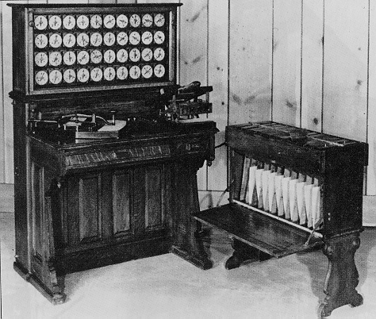
Electro-mechanical computers
A closer look at the Census Tabulating Machine

Slide 36
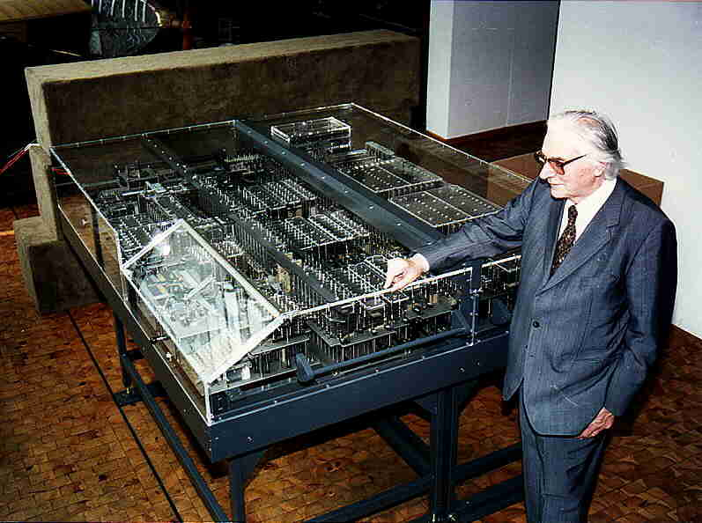
Konrad Zuse – Z1 Computer
First freely programmable computer, electro-mechanical punch tape control.
Notes:
binary electrically driven mechanical calculator with limited programmability, reading instructions from a punched tape. The Z1 never worked well, though, due to the lack of sufficiently precise parts. The Z1 and its original blueprints were destroyed during World War II.

Slide 37
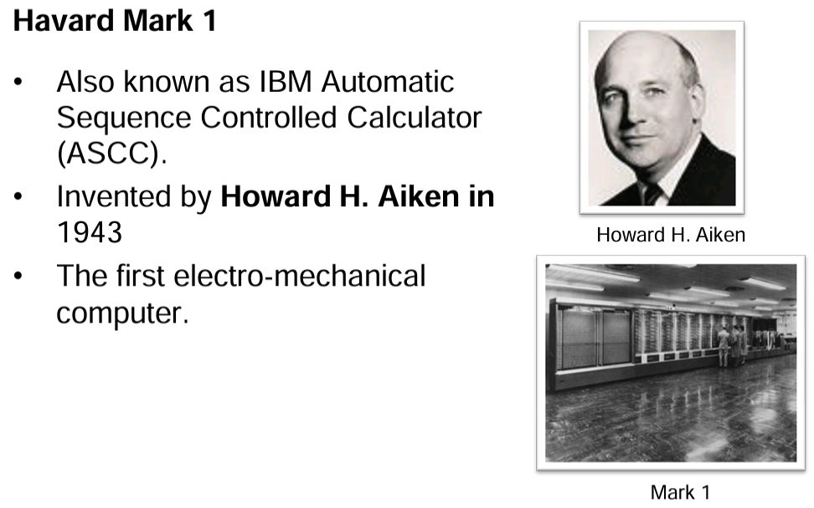
Electro-mechanical computers
Notes:
While a professor of Physics at Harvard, Howard Aiken, illustrated above, was supported by IBM to build the ASCC computer (Automatic Sequence Controlled Calculator). The computer had mechanical relays (switches) which flip-flopped back and forth to represent mathematical data. It was huge (of course), weighting some 35 tons with 500 miles of wiring. The guts of the machine was comprised of IBM counting machines.

Slide 38
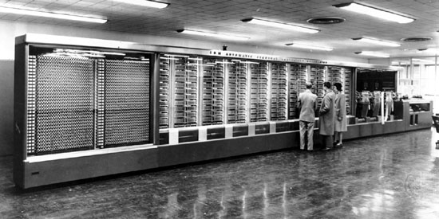
Electro-mechanical computers
The IBM Automatic Sequence Controlled Calculator (ASCC) Computer was created by IBM for Harvard University, which called it the Mark I. First universal calculator.

Slide 39
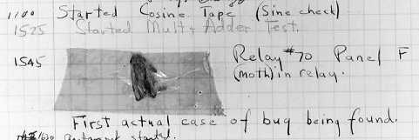
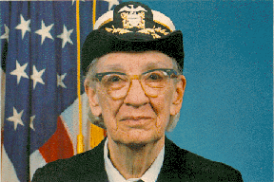
Electro-mechanical computers
The first computer bug---U.S. Rear Admiral Dr. Grace Murray Hopper
Notes:
The is a picture of the first computer bug. The lady is U.S. Rear Admiral Dr. Grace Murray Hopper, who worked with Howard Aiken from 1944 and used his machine for gunnery and ballistics calculation for the US Bureau of Ordnance’s Computation project.
One day, the program she was running gave incorrect results and, upon examination, a moth was found blocking one of the relays. The bug was removed and the program performed to perfection. Since then, a program error in a computer has been called a bug, even though it would take a mighty tiny bug to interfere with the workings of a modern microscopic microprocessor.
Nancy Head has contributed the following additional information about Dr. Hopper:
Dr. Hopper greatly simplified programming through the COBOL language which was the first programming language to allow the use of regular English for variable names and logical operations. She also introduced the concept and standardization of "compilers“, now a standard feature of programming languages. The compiler translates the programmer’s code into machine language, thus sparing the programmer the onerous task of doing it it herself. This contributed to business use of computers and modern data processing because regular businesspersons and scientists (not just mathematicians and computer scientists) could learn to program computers.

Slide 40
Electronic digital computers
From
John Vincent Atanasoff’s
1939
Atanasoff-Berry Computer (ABC)
to
the present day
Notes:
John Vincent Atanasoff’s contribution to the history of computers is little known, thanks to the preoccupations of his university and the shenanigans of two rival inventors of electronic digital machines. Read on to find out more…

Slide 41
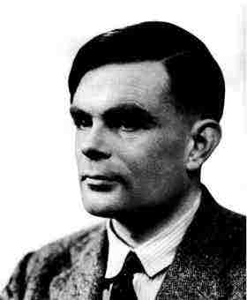
Electronic digital computers
Alan Turing 1912-1954
The Turing Machine Aka The Universal Machine 1936
Notes:
The story of modern electronic digital computing should start with Alan Turing who published a paper in 1936 On Computable Numbers, with an application to the Entscheidungsproblem. The paper proved that a machine capable of processing a stream of 1s and 0s according to programmed instructions would be capable of solving any problem that would count as a 'definite method.' As it happens, the set of problems included in this definition is the universe of mechanically solvable problems. Hence, the Turing Machine is also known as the Universal Machine, the theoretical precursor to the electronic digital computer which Atanasoff was soon to invent.

Slide 42
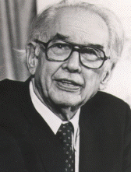
John Vincent Atanasoff (1903-1995)
Physics Prof
At
Iowa State
University,
Ames, IA
Notes:
Interesting story of how Atanasoff came up the stroke of genius to design his computer the way he did. He’d been thinking about it for a long time, convinced there had to be a way of doing math mechanically and thus save his PhD students at Iowa State College (now Iowa State University) in Ames, Iowa, from wasting time on math when they could be doing more interesting work in Physics. One evening in the winter of 1937, the problem proved particularly taxing for him, so he did what he was accustomed to doing in situations such as this: he got into his car and drove at high speeds for several hours, thus effectively clearing his mind. Eventually he crossed into the neighboring state of Illinois and stopped at a bar where he ordered a draft of liquid refreshment (bourbon). This had a wondrous effect on his state of mind, enabling him to think with a calm clarity that led step-by-step to coherent conclusions about the design of his electronic digital computer.
Back at the lab, in the Spring of 1939, he hired Clifford Berry, an bright electrical engineering student, and together they invented the Atanasoff-Berry Computer, the ABC. Within a year, the basic machine was completed and a paper written documenting its design. The paper was forwarded to the university’s patent lawyer. With World War II well underway, Atanasoff was given leave from the university to join the Naval Ordnance Laboratory for defense-related work. Work on the ABC came to a halt. The patent was never filed….

Slide 43
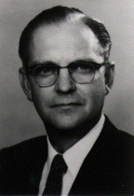
Clifford Berry (1918-1963)
PhD student
of
Dr. Atanasoff’s
Notes:
Dr. Clifford Berry had a distinguished career of his own outside of contribution in the invention of the electronic digital computer. He was issued 19 patents in the area of mass spectrometry, 11 patents in various areas of vacuum and electronics and, at the time of his death, had 13 patents pending. He died suddenly on October 30, 1963.

Slide 44
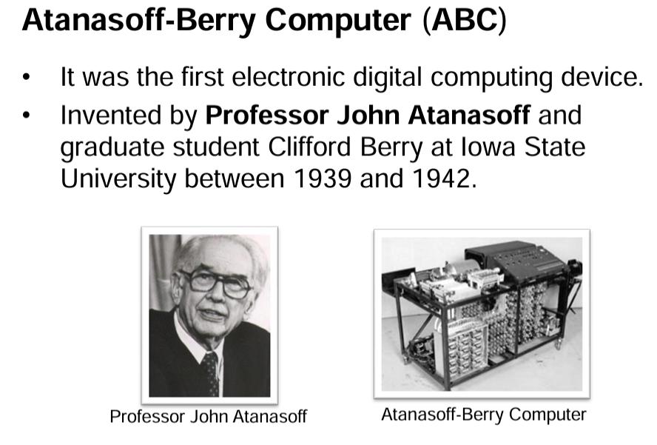
Electronic digital computers

Slide 45
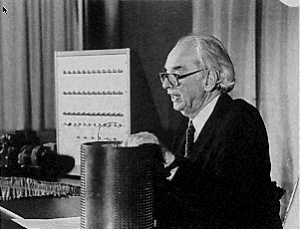
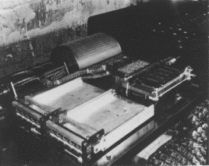
1939 The Atanasoff-Berry Computer (ABC)
The ABC was the first electronic digital computer, invented by John Vincent Atanasoff
Notes:
The ABC was a digital computer, so-called because it processed data in discrete, digital units (the digits 1 and 0). It also used the binary (base 2) number system in computation, the results being converted to and from decimal (base 10) for the purposes of human consumption. Being binary, the data could easily be represented electronically since switches natural have two states—on and off—which lend themselves to representing the numbers or values 1 and 0. The ABC used vacuum tubes, punched cards and a memory device that looked like a drum (shown in the pictures on the slide being held by Atanasoff and as it was located in the working machine).

Slide 46
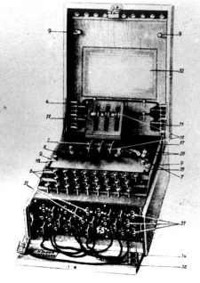
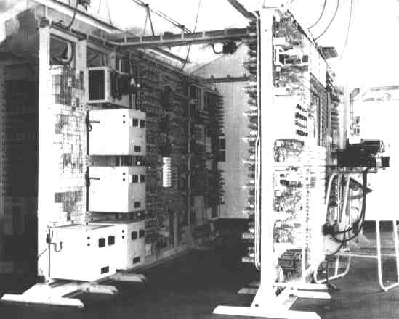
1943 Bletchley Park’s Colossus
The Enigma
Machine
Notes:
Another little known story in the history of computers relates the work of the government boffins in World War II Britain, Turing included. Turing made a major contribution to the development of a sophisticated computing machine called the Colossus which was used to help crack the codes of the German Enigma Machine. The story didn’t come out till the 1970s because it was top secret, for obvious reasons.
You can read more about cryptography in a fascinating book written by Simon Singh: THE CODE BOOK. The Secret History of Codes and Code-Breaking.
Those of you interested in learning more about cryptography and even using cryptography to protect your privacy can work your way through our tutorial on PGP (Pretty Good Privacy) which you will find available free of charge online at http://www.pitt.edu/~poole/PGPintro.htm.

Slide 47
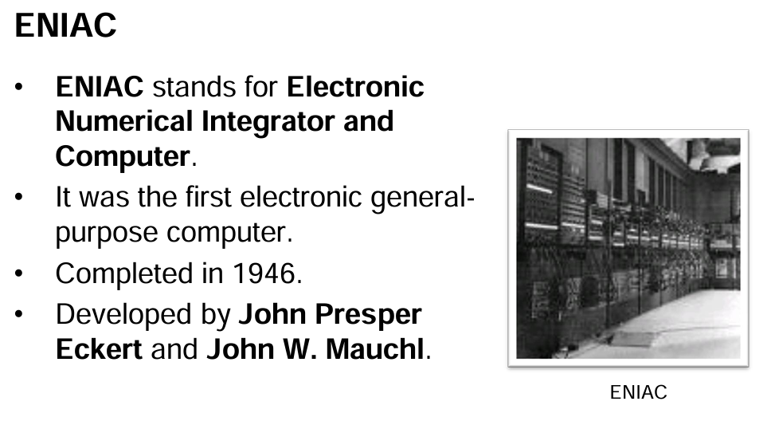

Slide 48

1946 –John Eckert & John W. Mauchly – ENIAC 1 Computer
ENIAC was short for Electronic Numerical Integrator And Computer. It was the first general purpose (programmable to solve any problem) electric computer. It contained over 17,000 vacuum tubes, weighed 27 tones and drew 150 kW of power to operate.

Slide 49
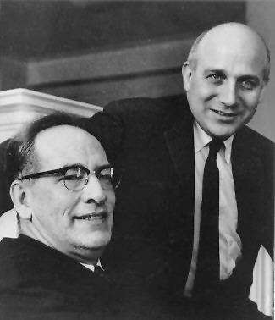
1946 The ENIAC
John Presper Eckert
(1919-1995)
and
John Mauchly
(1907-1980)
of the
University of Pennsylvania Moore School of Engineering
Notes:
J. Presper Eckert (at right in the picture on this slide) and John Mauchly were professors in the Moore School of Engineering at the University of Pennsylvania. Mauchly invited himself to Atanasoff’s home for a long weekend in order to check our the ABC. Atanasoff made him welcome, showed him his machine, and gave him a copy of the paper describing the workings of the machine that already had been filed with the Iowa State College’s patent lawyer. Mauchly returned to Pennsylvania and, together with Eckert, designed and built the ENIAC (Electronic Numerical Integrator and Computer) which was commissioned by the U.S. Department of Defense and delivered in 1946.
Eckert and Mauchly successfully filed for the patent as inventors of the electronic digital computer, ignoring Atanasoff’s work. Some thirty years later, in 1972, this injustice was rectified when Honeywell (for Atanasoff) successfully challenged Sperry Rand (the company that acquired Eckert and Mauchly’s patent), and Atanasoff and Berry were duly credited as being the inventors of the electronic digital computer.
Mauchly died in 1980. Eckert died in 1995, one week before the nonogenarian Atanasoff. You might say that Atanasoff had the last laugh.

Slide 50
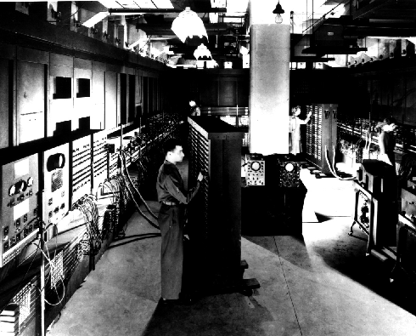
The ENIAC: Electronic Numerical Integrator and Computer
Notes:
The ENIAC: 30 tons, 18,000 vacuum tubes, with the computing power of little more than the modern calculator…..

Slide 51
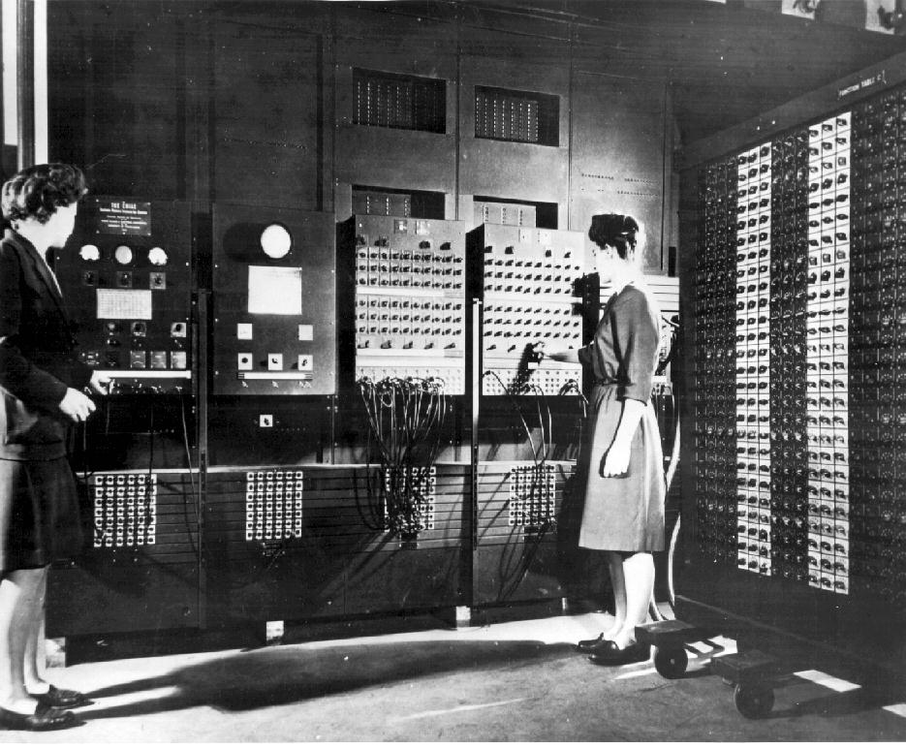
Programming the ENIAC
Notes:
The ENIAC was programmed by rewiring the machine, instruction by instruction, tedious work carried out mostly by women working for the U.S. Ordnance Office. The machine was intended for use in the calculation of ballistics trajectories for the big guns of World War II. It was ready a bit late for that, but nonetheless was an immensely significant achievement on Eckert and Mauchly’s part. Such a shame they neglected to recognize Atanasoff’s contribution to their endeavors.
The lady programmers were known as computers, for a while at least…..

Slide 52
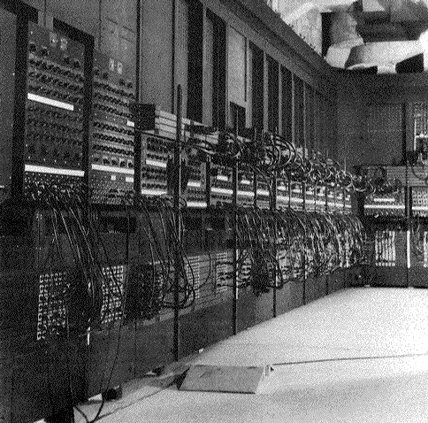
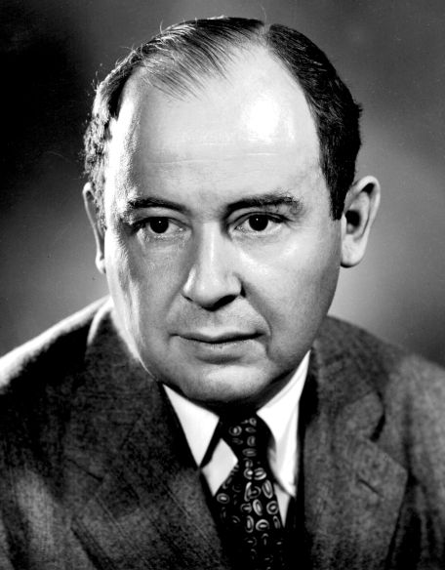
ENIAC’s Wiring!
John Von Neumann
John Von Neumann came up with the bright idea of using part of the computer’s internal memory (called Primary Memory) to “store” the program inside the computer and have the computer go get the instructions from its own memory, just as we do with our human brain.
Notes:
Like all the earliest electronic digital computers, the ENIAC was programmed manually; that is to say, the programmers wrote the programs out on paper, then literally set the program for the computer to perform by rewiring it or hard-wiring it—plugging and unplugging the wires on the outside of the machine. Hence all those external wires in the picture above and on the previous slide.
Then along came John Von Neumann, who worked at Princeton’s Institute for Advanced Study and who collaborated with Eckert and Mauchly. He came up with the bright idea of using part of the computer’s internal memory (called Primary Memory) to “store” the program inside the computer and have the computer go get the instructions from its own memory, just as we do with our human brain. Neato! No more intricate, complex, cumbersome external wiring. Much faster; much more efficient.
Unfortunately, it didn’t solve the problem of the possibility of error. As long as humans are around, we’ll always have that!
It’s iroonic that Eckert and Mauchly were upset when Von Neumann was given credit for this “stored program concept,” because they thought they deserved it, too. Now why didn’t they think the same about Atanasoff? Go figure!

Slide 53

1951 Univac
Typical 1968 prices—EX-cluding maintenance & support!
Notes:
Tote it up… $1,801,035 in 1968 dollars. According to The Inflation Calculator found at http://www.westegg.com/inflation/, it would be about $8,973,207 in year 2000 dollars. So you’d have to multiply that by five, easy, in today’s money, and all for the equivalent of the calculator you keep in your school bag.

Slide 54
“What hath God wrought!” (first telegraph message sent by Samuel Morse, 1844) Electronic and computing technology quickly progressed—at an ever-accelerating pace— from vacuum tubes (Lee de Forrest, the audion, 1907) to transistors (William Shockley et al. 1947) to semiconductors (Jack Kilby & Robert Noyce, 1958) to microprocessors (M.E. “Ted” Hoff, 1971) to networking and the Internet (Vinton Cerf & Robert Kahn, 1982] to the World Wide Web (Tim Berners-Lee, 1991) and beyond… Whatever next?…
Notes:
(first telegraph message sent by Samuel Morse, 1844) Electronic and computing technology quickly progressed—at an ever-accelerating pace— from vacuum tubes (Lee de Forrest, the audion, 1907) to transistors (William Shockley et al. 1947) to semiconductors (Jack Kilby & Robert Noyce, 1958) to microprocessors (M.E. “Ted” Hoff, 1971) to networking and the Internet (Vinton Cerf & Robert Kahn, 1982] to the World Wide Web (Tim Berners-Lee, 1991) and beyond… -----------------------
The ABC and the ENIAC used vacuum tubes, invented by Lee de Forrest, for the Central Processor. William Shockley and his team at Bell Labs invented the transistor in 1948 and IBM soon used these much smaller electronic switching devices in place of vacuum tubes in their computers of the 1950s and 60s.
Speed, in electronic terms, is essentially a function of space. If you can pack the memory components closer together, you increase the speed of the machine. The transistor was a fraction the size of a vacuum tube and thus enabled significant advances in computing power.
Then Kilby and Noyce, who founded Intel Corporation, invented the semiconductor which led directly, in 1971, to Hoff’s invention of the first microprocessor, also at Intel. The semiconductor is the equivalent of a transistor, only it’s layered onto a thin sliver of silicon using photomasking techniques. It revolutionized the computer industry, leading quickly to the invention of the pocket calculator, the personal computer, and the proliferation of computing devices throughout the manufacturing industry.
The Internet began in 1969 as ARPANet, a project of the Advanced Research Projects Agency (ARPA). One of the ideas behind its development was to build a fail safe communications network that the military establishment of the U.S. and allies could rely on in the event of nuclear war. During his tenure from 1976-1982 with the U.S. Department of Defense's Advanced Research Projects Agency (DARPA), and under the leadership of Dr.
J.C.R. Licklider, Vinton Cerf played a key role leading to the development of Internet and Internet-related data packet and security technologies, including the design and definition of the TCP/IP set of protocols for the Internet. These protocols were officially adopted in 1982, the year the Internet as such was born.
In 1991, the set of standards for the World Wide Web, now controlled by the World Wide Web Consortium (aka W3C on the web at http://www.w3.org) were launched. These standards were developed by Tim Berners-Lee who is recognized as the inventor of the World Wide Web. To quote from his official bio, which can be found at http://www.w3.org/People/Berners-Lee/Longer.html:
“In 1989, [Tim Berners-Lee] proposed a global hypertext project, to be known as the World Wide Web. Based on the earlier "Enquire" work, it was designed to allow people to work together by combining their knowledge in a web of hypertext documents. He wrote the first World Wide Web server, "httpd", and the first client, "WorldWideWeb" a what-you-see-is-what-you-get (WYSIWYG) hypertext browser/editor which ran in the NeXTStep environment. This work was started in October 1990, and the program "WorldWideWeb" first made available within CERN in December, and on the Internet at large in the summer of 1991.”
Today, you’ll find computers everywhere you care to look and they are controlling an increasingly broad spectrum of the devices we use as we go about our daily lives.
And we ain’t seen nuthin’ yet.

Slide 55

1947 –The transistor
Invented by William Shockley (seated) John Bardeen & Walter Brattain at Bell Labs. The transistor replaces bulky vacuum tubes with a smaller, more reliable, and power saving solid sate circuit.

Slide 56

1951 – UNIVAC
25 feet by 50 feet in size
5,600 tubes,
18,000 crystal diodes
300 relays
Internal storage capacity of 1,008 fifteen bit words was achieved using 126 mercury delay lines
First commercial computer - Between 1951 and 1958, 47 UNIVAC I computers were delivered.

Slide 57

1951 – UNIVAC Mercury delay unit (1 of 7)‏
UNIVAC mercury delay units containing 18 delay lines, each of which stored 120 bits. Total of 2,160 bits, or 144 fifteen bit words per memory unit.

Slide 58

1951 – UNIVAC

Slide 59


1951 – UNIVAC
UNIVAC tube board and individual vacuum tube.

Slide 60

1953 – IBM 701 EDPM Computer
IBM enters the market with its first large scale electronic computer.
It was designed to be incomparable with IBM's existing punch card processing system, so that it would not cut into IBM's existing profit sources.

Slide 61

Grace Hopper 1906-1992
Developed the first compiler (A-0, later ARITH-MATIC, MATH-MATIC and FLOW-MATIC) while working at the Remington Rand corporation on the UNIVAC I.
Later returned to the NAVY where she worked on COBOL and was eventually promoted to Rear Admiral.

Slide 62


Grace Hopper 1906-1992
Rear Admiral Grace Hopper, US Navy, and other programmers at a UNIVAC console - 1957
Grace Hopper (January 1984)‏

Slide 63

1954 – FORTRAN
John Backus & IBM invent the first successful high level programming language, and compiler, that ran on IBM 701 computers.
FORmula TRANslation was designed to make calculating the answers to scientific and math problems easier.

Slide 64


1958 – Integrated Circuit
Jack Kilby at Texas Instruments & Robert Noyce at Fairchild semiconductor independently invent the first integrated circuits or “the chip”.
Jack Kilby was awarded the National Medal of Science and was inducted into the National Inventors Hall of Fame, and received the 2000 Nobel Prize in Physics for his work on the integrated circuit.

Slide 65


1960 – First commercial transistorized computers
DEC introduced the PDP-1and IBM released the 7090 which was the fastest in the world.

Slide 66

1962 – First computer game & word processor
Steve Russell at MIT invents Spacewar, the first computer game running on a DEC PDP-1.
Because the PDP-1 had a typewriter interface, editors like TECO (Text Editor and Corrector) were written for it.
Steve Piner and L. Peter Deutsch produced the first “word processor” called Expensive Typewriter (MIT's PDP-1 cost $100,000).

Slide 67


1964 – The mouse and window concept
Douglas Engelbart demonstrates the worlds first “mouse”, nicknamed after the “tail”.
SRI (Stanford Research Institute) received a patent on the mouse in 1970, and licensed it to apple for $40,000.

Slide 69
1969 - ARPANET
The precursor to the Internet as we know it, funded by ARPA (Advanced Research Projects Agency now DARPA) begins.
The first four nodes were located at:
UCLA
Stanford Research Institute
UC Santa Barbara
University of Utah

Slide 70


1970 – Intel 1103 Dynamic Memory Chip
Worlds first commercially available dynamic memory chip, 1024 bytes or 1KB

Slide 71


1971 – Intel 4004 Microprocessor
Worlds first microprocessor with 2,300 transistors, had the same processing power as the 3,000 cubic-foot ENIAC.

Slide 72

1973-1976 – Ethernet
Robert Metcalfe at Xerox invents Ethernet so that multiple computers can talk to a new laser printer. Originally, Ethernet used a large coaxial cable and ran at 3Mbit/sec.
Ethernet today runs over twisted pair (usually CAT5, or CAT6) and can achieve speeds of 10Megabit/sec to 1Gigabit (1000 Mbit/sec).

Slide 73


1974/1975 – Personal Computers
Scelbi Mark-8 Altair and IBM 5100 computers are first marketed to individuals (as opposed to corporations). They are followed by the Apple I,II, TRS-80, and Commodore Pet computers by 1977.

Slide 74

1977 – Growth of the ARPAnet

Slide 75


1978/1979 – First individual productivity software
VisiCalc Spreadsheet software and WordStar word processor are the “killer applications” for personal computers, especially for small business owners.

Slide 76

1981 – IBM PC
The IBM PC is introduced running the Microsoft Disk Operating System (MS-DOS) along with CP/M-86. The IBM PC's open architecture made it the de-facto standard platform, and it was eventually replaced by inexpensive clones.
CPU: Intel 8088 @ 4.77 MHz
RAM: 16 kB ~ 640 kB
Price: $5,000 - $20,000

Slide 77

1984 – Apple Macintosh
Apple introduces the first successful consumer computer with a WIMP user interface (Windows Icons Mouse & Pointer), modelled after the unsuccessful Xerox Alto computer.
Motorola 68000 @8Mhz
128KB Ram
US$1,995 to US$2,495

Slide 78


Slide 79


Slide 80


Slide 81


Slide 82


Slide 83


Slide 84


Slide 85


Slide 86


Slide 87


Slide 88


Slide 89


Slide 90


Slide 91


Slide 92


Slide 93


Slide 94

Super computers
Where Are the World’s Fastest Supercomputers?
The 500 fastest supercomputers are spread across 35 countries

Slide 95

Fastest super computer
Since June 2022, the United States' 'Frontier' is the most powerful supercomputer
'Frontier' is capable of more than a billion, billion operations a second, making it the first exascale supercomputer.
Supercomputers have been used to discover more about diseases including COVID-19 and cancer.

Slide 96


Slide 97


Slide 98
Frontier, the new number 1, is built by Hewlett Packard Enterprise (HPE) and housed at the Oak Ridge National Laboratory (ORNL) in Tennessee, USA.
2. Fugaku, which previously held the top spot, is installed at the Riken Center for Computational Science in Kobe, Japan. It is three times faster than the next supercomputer in the top 10.
3. LUMI is another HPE system and the new number 3, crunching the numbers in Finland.
4. Summit, an IBM-built supercomputer, is also at ORNL in Tennessee. Summit is used to tackle climate change, predict extreme weather and understand the genetic factors that influence opioid addiction.
5. Another US entry is Sierra, a system installed at the Lawrence Livermore National Laboratory in California, which is used for testing and maintaining the reliability of nuclear weapons.

